Slide 1
Artificial Neural Networks
Lecture 9
Deep Learning
Some slides were adapted/taken from various sources, including Andrew Ng’s Coursera lectures and Prof. Lior Rokach, Mark Last

Slide 2
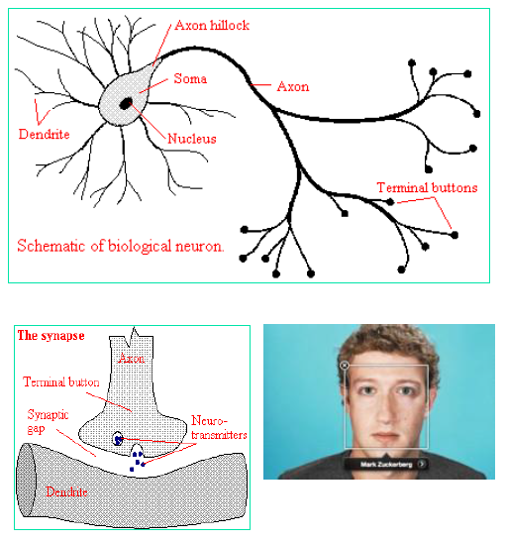
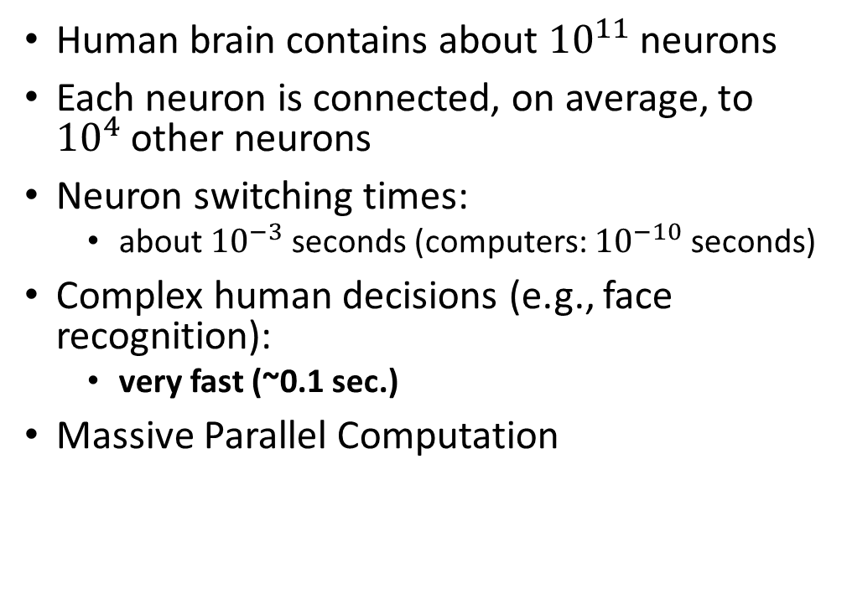
Biological Motivation
Human brain contains about ${10}^{11}$neurons
Each neuron is connected, on average, to ${10}^{4}$other neurons
Neuron switching times:
about ${10}^{−3}$seconds (computers: ${10}^{−10}$seconds)
Complex human decisions (e.g., face recognition):
very fast (~0.1 sec.)
Massive Parallel Computation

Slide 3
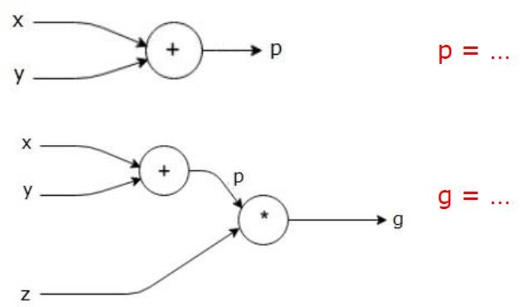
Computational Graphs
A computational graph is defined as a directed graph where the nodes correspond to mathematical operations.
Source: https://www.tutorialspoint.com/python_deep_learning/python_deep_learning_computational_graphs.htm

Slide 4
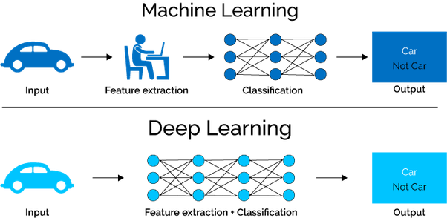

Slide 5
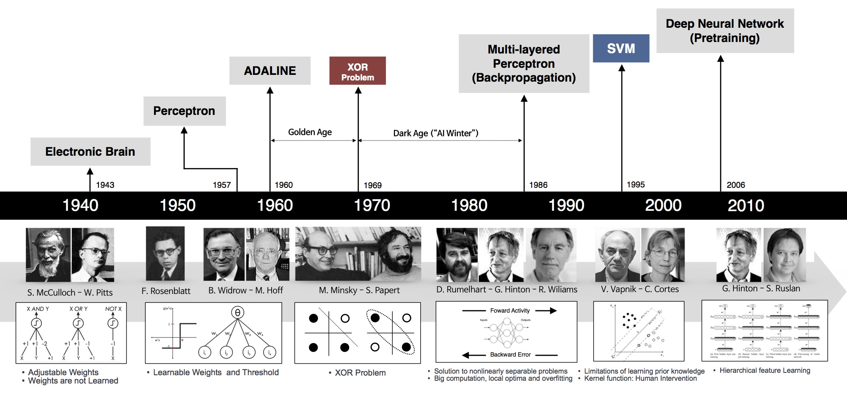
History of Deep Learning

Slide 6
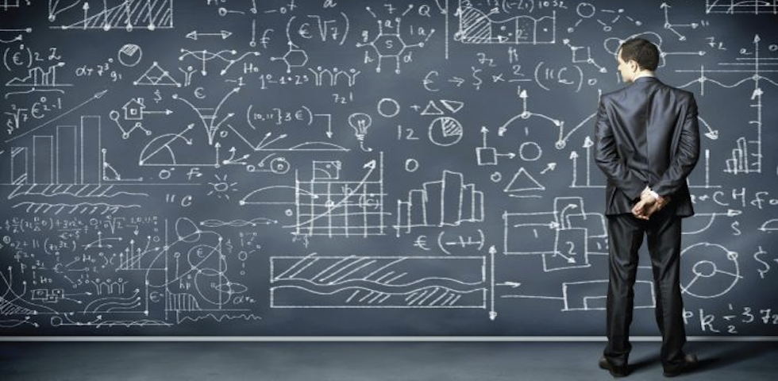
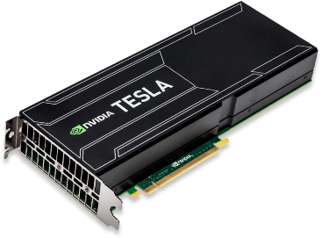

Deep Learning: The Catalysts
A series of advances in machine learning algorithms: weight initialization, regularization, new activation functions
Huge increases in computing power from GPUs and cloud computing.
The Internet yields orders of magnitude more data to train on.
Notes:
Google Brain, with about 1 million simulated neurons and 1 billion simulated connections, was ten times larger than any deep neural network before it.
So back at Stanford, Ng started developing bigger, cheaper deep-learning networks using graphics processing units (GPUs) — the super-fast chips developed for home-computer gaming3. Others were doing the same. “For about US$100,000 in hardware, we can build an 11-billion-connection network, with 64 GPUs,” says Ng.
In that competition, teams train computer programs on a data set of about 1 million images that have each been manually labelled with a category. After training, the programs are tested by getting them to suggest labels for similar images that they have never seen before. They are given five guesses for each test image; if the right answer is not one of those five, the test counts as an error. Past winners had typically erred about 25% of the time. In 2012, Hinton's lab entered the first ever competitor to use deep learning. It had an error rate of just 15% (ref. 4).

Slide 7
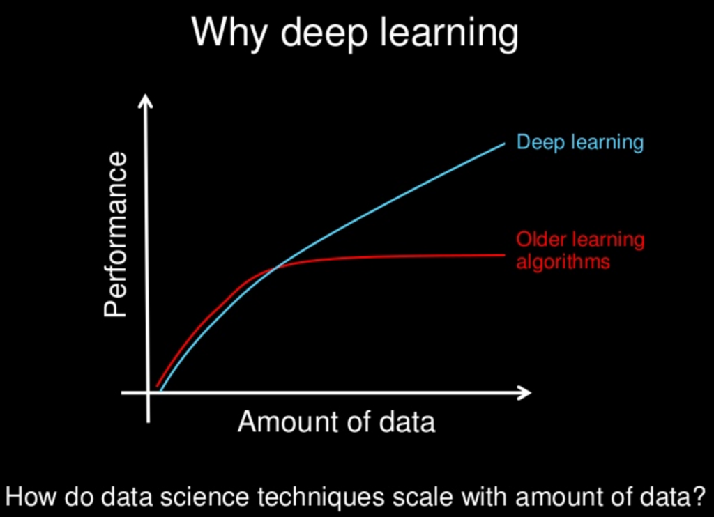

Slide 8
ImageNet Challenge
http://www.image-net.org/challenges/LSVRC/2014/
Classification over 1000 categories:
1.2 million training images
50,000 validation images
150,000 testing images
Classification
Assign to each image label 5 guesses
Classification & Localization
5 guesses: label + bounding box
Detection:
any number of objects in image (including zero)
False positives are penalized

Slide 9
Top 5 Labels - Classification
http://www.image-net.org/challenges/LSVRC/2014/

Slide 10
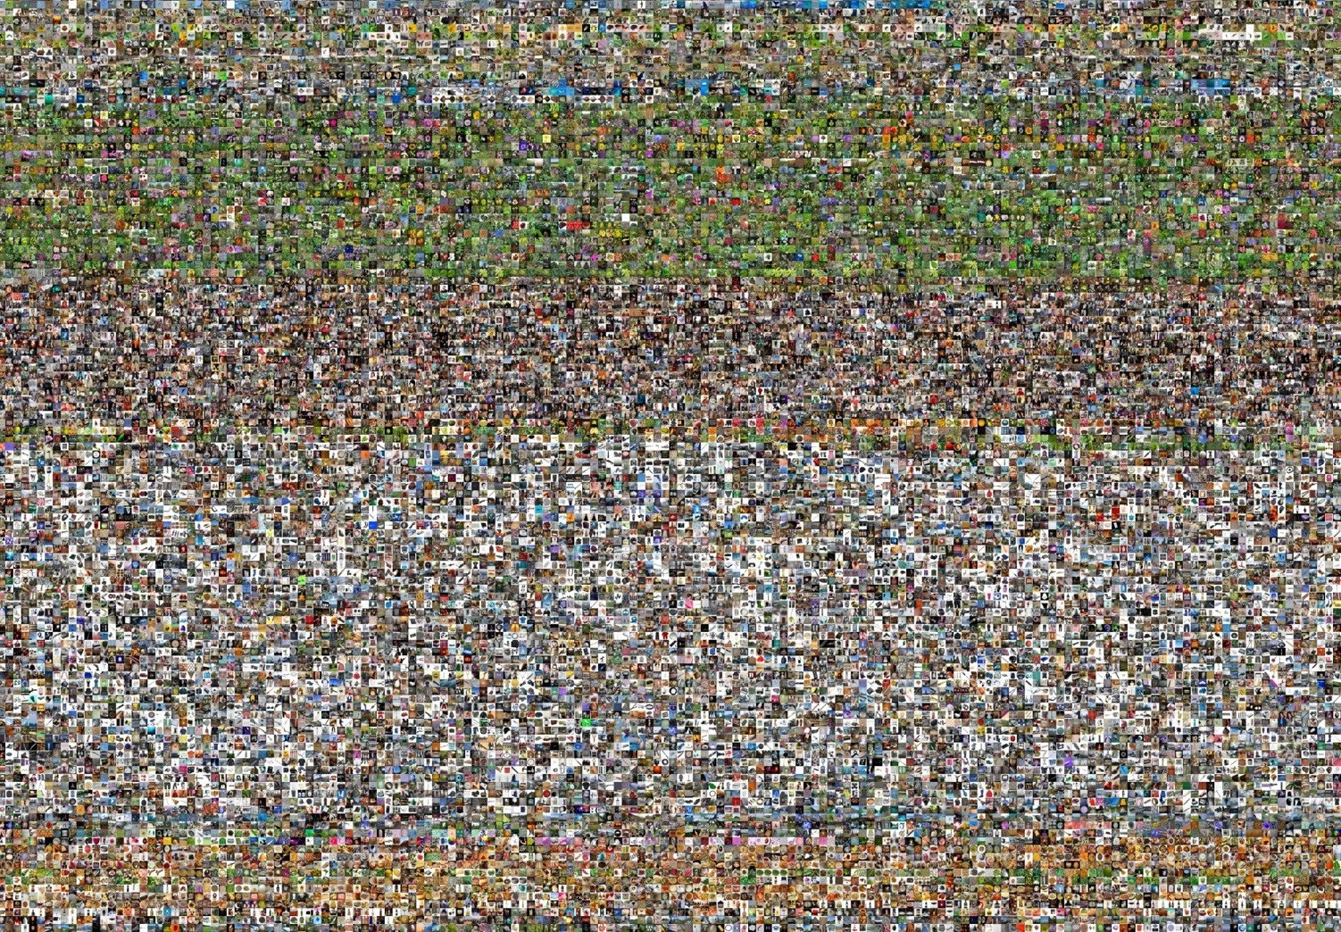
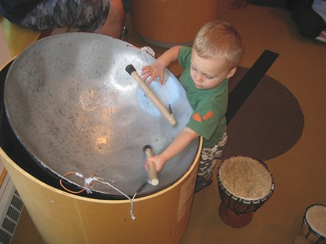
The Image Classification Challenge: 1,000 object classes
1,431,167 images
Steel drum
Output:
Scale T-shirt
Steel drum Drumstick Mud turtle
Output:
Scale T-shirt
Giant panda Drumstick Mud turtle
✔
✗
Russakovsky et al. arXiv, 2014

Slide 11
Imagenet 2010: top rankers
N | Error-5 | Algorithm | Team | Authors
1 | 0.28 | Descriptor Coding + SVM | NEC | Zeiler
2 | 0.34 | Fisher kernel + SVM | XRCE | Min LIN
3 | 0.58 | LI2C | NTU_WZX | Zeiler Fergus
4 | 0.61 | KNN | LIG | Andrew Howard
5 | 0.79 | Canonical Correlation Analysis | NII | Pierre Sermanet et al

Slide 12
Imagenet 2012: top rankers
http://www.image-net.org/challenges/LSVRC/2012/results.html
N | Error-5 | Algorithm | Team | Authors
1 | 0.153 | Deep Conv. Neural Network | Univ. of Toronto | Krizhevsky et al
2 | 0.262 | Features + Fisher Vectors + Linear classifier | ISI | Gunji et al
3 | 0.270 | Features + FV + SVM | OXFORD_VGG | Simonyan et al
4 | 0.271 | SIFT + FV + PQ + SVM | XRCE/INRIA | Perronin et al
5 | 0.300 | Color desc. + SVM | Univ. of Amsterdam | van de Sande et al

Slide 13
Imagenet 2013: top rankers
http://www.image-net.org/challenges/LSVRC/2013/results.php
N | Error-5 | Algorithm | Team | Authors
1 | 0.117 | Deep Convolutional Neural Network | Clarifi | Zeiler
2 | 0.129 | Deep Convolutional Neural Networks | Nat.Univ Singapore | Min LIN
3 | 0.135 | Deep Convolutional Neural Networks | NYU | Zeiler Fergus
4 | 0.135 | Deep Convolutional Neural Networks |  | Andrew Howard
5 | 0.137 | Deep Convolutional Neural Networks | Overfeat NYU | Pierre Sermanet et al

Slide 14
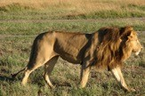
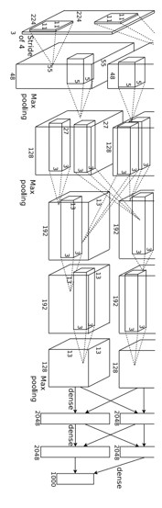
Year 2010
Year 2012
SuperVision
Year 2014
GoogLeNet
Year 2015
MSRA
NEC-UIUC
VGG
Pooling Convolution Softmax Other
Image
conv-64
conv-64
maxpool
Dense descriptor grid: HOG, LBP
conv-128
conv-128
maxpool
conv-256
conv-256
maxpool
Coding: local coordinate, super-vector
conv-512
conv-512
maxpool
Pooling, SPM
conv-512
conv-512
maxpool
Linear SVM
fc-4096
fc-4096
fc-1000
softmax
[Lin CVPR 2011]
[Krizhevsky NIPS 2012]
Lion image by Swissfrog is licensed under CC BY 3.0
Figure copyright Alex Krizhevsky, Ilya Sutskever, and Geoffrey Hinton, 2012. Reproduced with permission.
[Szegedy arxiv 2014]
[Simonyan arxiv 2014]
[He ICCV 2015]

Slide 15
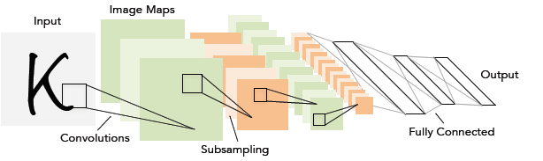


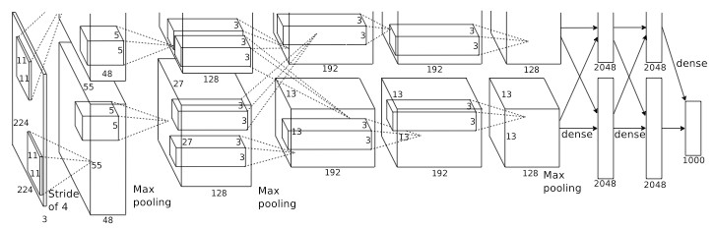

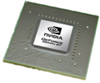

1998
LeCun et al.
LeNet5
# of transistors
10⁶
# of pixels used in training
10⁷
2012
Krizhevsky et al.
AlexNet
# of transistors
GPUs
# of pixels used in training
₁₀14
10⁹
Figure copyright Alex Krizhevsky, Ilya Sutskever, and Geoffrey Hinton, 2012. Reproduced with permission.

Slide 16
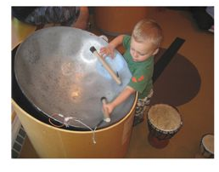
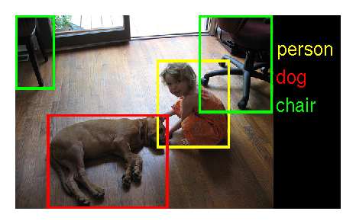
ImageNet Large Scale Visual Recognition Challenge (ILSVRC)
More than 14 million have been hand-annotated by the project to indicate what objects are pictured.
ImageNet contains more than 20,000 categories.
Pantam drum
(steel drum)
Goblet drum

Slide 17
Shallow
22 Layers
8 Layers
152 Layers
Human (5.1%)
AlexNet
Clarifai
GoogleNet
ResNet
Inception-v4
WMW
Source: http://www.image-net.org/challenges/LSVRC

Slide 18
THE Perceptron MODEL

Slide 19
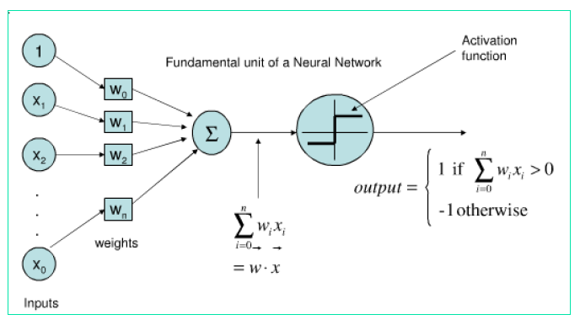
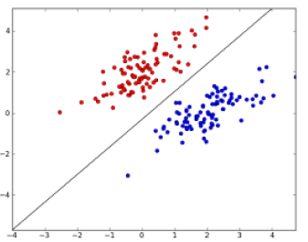
The Perceptron (“neuron”)
A neural network: A set of connected input/output units (neurons) where each connection has a weight associated with it
During the learning phase, the network learns by adjusting the weights
Also referred to as connectionist learning

Slide 20
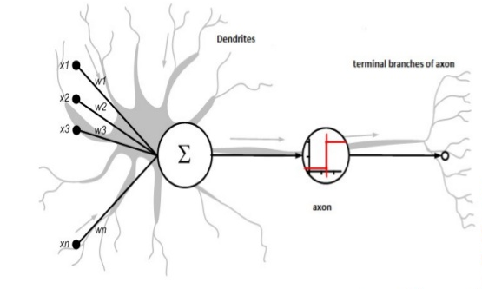
Perceptron Model: Biology inspired Neurons

Slide 21
Perceptron Model
-1
x₁
x₂
x₃
x_{m}
b_{i} :Bias
w_{i1}
Σ
f
a_{i}
Neuron^{i} Activation
w_{im}
function
Input Synaptic Output
Weights

Slide 22
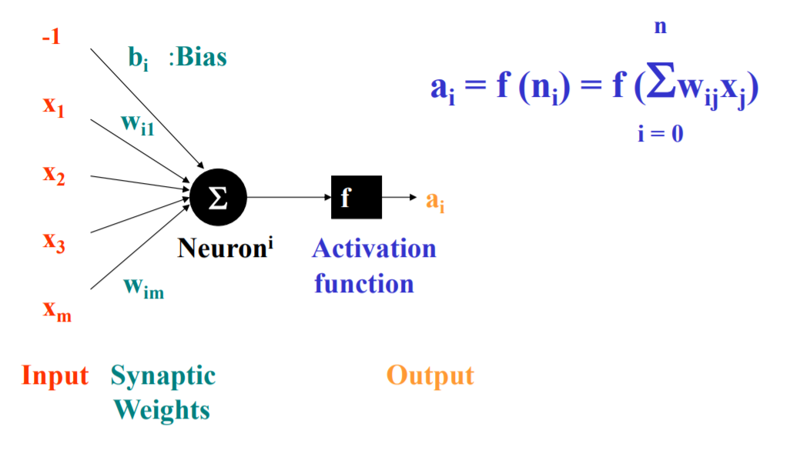
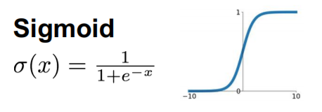
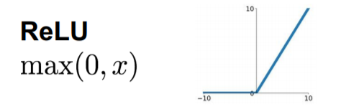
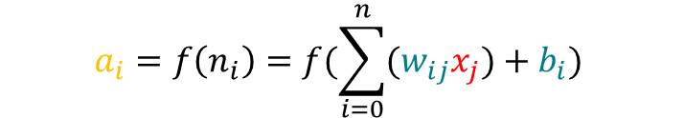
Perceptron
$$a_{i}=f\left(n_{i}\right)=f(\sum_{i=0}^{n}{{(w}_{ij}x_{j})+b_{i})}$$

Slide 23
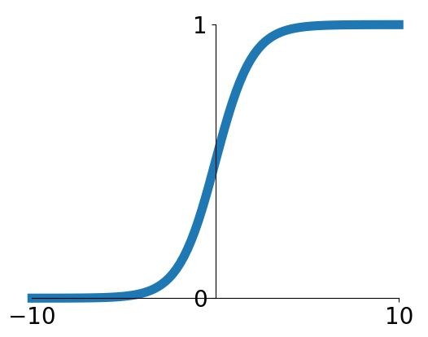
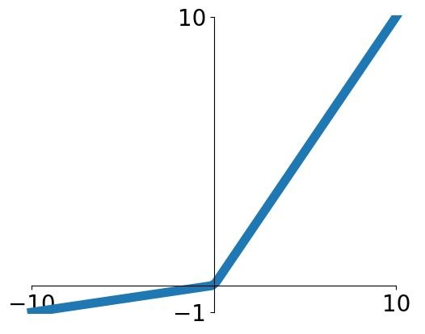
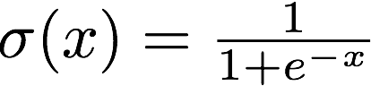
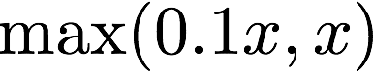
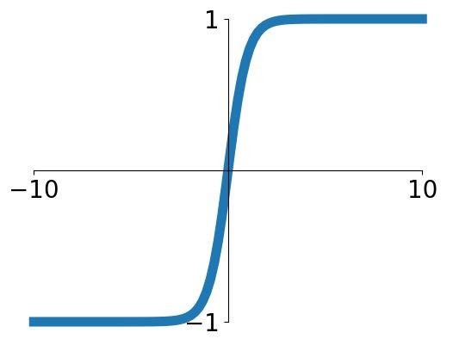
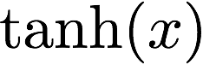
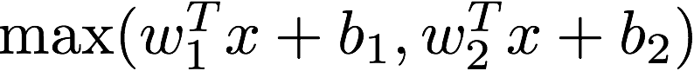
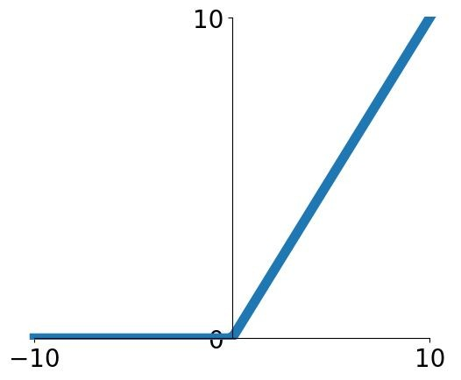
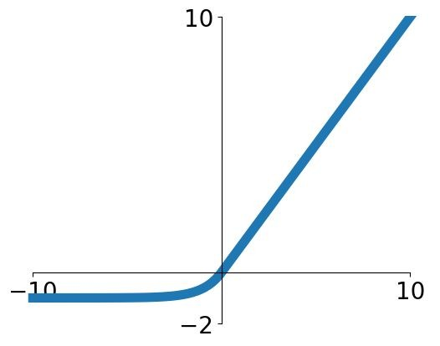
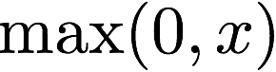
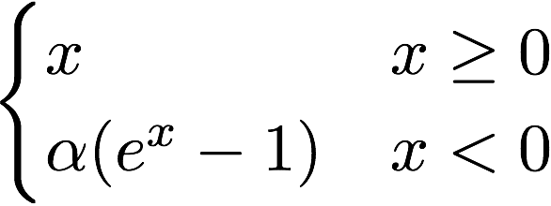
The Most Popular Activation functions
Sigmoid
tanh
Leaky ReLU
Maxout
ReLU
ELU

Slide 24
THE Perceptron MODEL

Slide 25
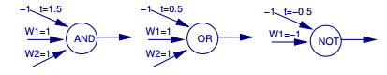
Perceptrons and Boolean Functions
If inputs are all 0’s and 1’s and outputs are all 0’s and 1’s…
Can learn the function x₁ ∧ x₂
Can learn the function x₁ ∨ x₂ .
X₂
X₁
X₂
X₁

Slide 26
Perceptrons and Boolean Functions
Can learn any conjunction of literals, e.g.
x₁ ∧ ~x₂ ∧ ~x₃ ∧ x₄ ∧ x₅
Can learn any disjunction of literals
e.g. x₁ ∧ ~x₂ ∧ ~x₃ ∧ x₄ ∧ x₅
Can learn majority function
f(x₁,x₂ … x_{n}) = 1 if n/2 x_{i}’s or more are = 1
0 if less than n/2 x_{i}’s are = 1

Slide 27
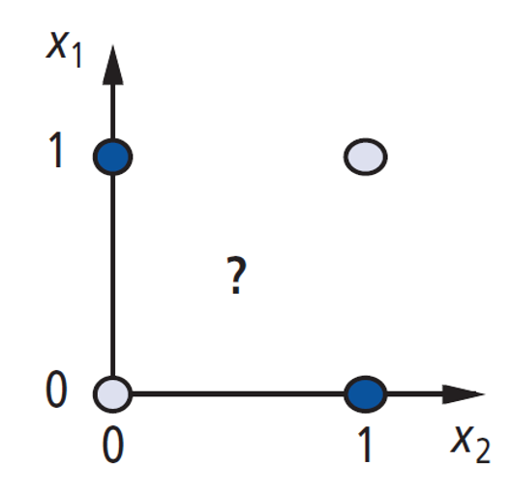
The XOR Problem
Single perceptron can’t learn XOR function
f(x₁,x₂) = x₁ XOR x₂ = (x₁ ∧ ~x₂) ∨ (~ x₁ ∧ x₂)
For XOR function we need more than a single perceptron

Slide 28
Multilayer

Slide 29
Artificial Neural Network multilayer perceptron
Neurons
Weights
Hidden Layer
Output Layer
Inputs

Slide 30
Multi-Layer Neural Network Model
Inputs
Output
Age
34
.6
.4
.2
Σ
0.6
.1
.5
Gender
Σ
2
.2
.3
.8
.7
Σ
“Probability of beingAlive”
Stage
4
.2
Dependent variable
Prediction
Independent variables
Weights
HiddenLayer
Weights

Slide 31
“Combined logistic models”
Inputs
Output
Age
34
.6
.5
0.6
.1
Gender
2
Σ
.7
.8
“Probability of beingAlive”
Stage
4
Dependent variable
Prediction
Independent variables
Weights
HiddenLayer
Weights

Slide 32
Inputs
Output
Age
34
.2
.5
0.6
Gender
2
Σ
.3
.8
“Probability of beingAlive”
Stage
4
.2
Dependent variable
Prediction
Independent variables
Weights
HiddenLayer
Weights

Slide 33
Age
34
.6
.4
.2
Σ
0.6
.1
.5
Gender
2
Σ
.3
.2
.8
.7
Σ
“Probability of beingAlive”
Stage
4
.2
Dependent variable
Prediction
Independent variables
Weights
HiddenLayer
Weights

Slide 34
Inputs
Output
Age
34
.6
.2
.5
0.6
.1
Gender
1
Σ
.3
.7
.8
“Probability of beingAlive”
Stage
4
.2
Dependent variable
Prediction
Independent variables
Weights
HiddenLayer
Weights

Slide 35
Backpropagation
That’s it!
That’s the backpropagation algorithm.

Slide 36
Deep learning was not invented overnight
Inception
2016
Szegedy et al.
Electronic Brain
1943
McCulloch & Pitts
ADALINE
1960
Widrow & Hoff
Multi-layered
1986
Rumelhart, Hinton & Williams
1940
1950
1960
1970
1980
1990
2000
2010
2020
Today
Deep Belief Network
2006
Hinton
ResNet
2015
He et al.
Perceptron
1957
Rosenblatt
AlexNet
2012
Krizhevsky et al.
EfficientNet
2019
Tan & Le.
Backpropagation
1974
Werbos
XOR problem
1969
Minsky and Papert
LeNet
1998
Lecun

Slide 37
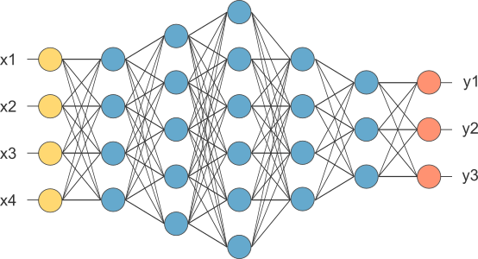
Deep learning involves many layers
https://www.kdnuggets.com/2017/11/deep-learning-works-quick-guide-everyone.html

Slide 38
Deep Learning vs. Shallow Learning
 | Deep Learning | Shallow Learning (aka traditional machine learning)
Good for | Excel in vision, NLP, audio: each sample (image) consists of many raw features (pixel) of the same nature. No idea on how feature engineering should be performed | Excel in tabular data where each sample (person) consists of features of different nature (age, gender)
Data | Requires a lot of training data (aka data intensive) | Can work with “small” data
Computational effort | Compute-intensive (typically training takes hours using GPUs) | Typically training takes seconds using standard CPUs
Law of conservation of difficulty (or some hard work has to be done somewhere) | Beyond known domains, it requires intricate knowledge in designing network architecture | Requires feature engineering based on prior knowledge
Interpretability | Considered to be black-box | Some of the models can be explained to the decision maker

Slide 39
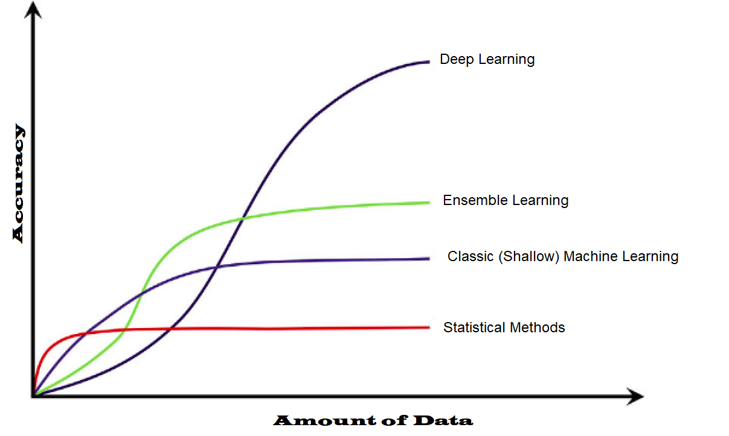

Slide 40
Problems of ANN
Input and target attributes can be discrete or real-valued (have to be numeric)
Output may include more than one target attribute (“a vector of attributes”)
The training data is abundant
The training data may contain errors
Each target attribute is a smooth, continuous function of input attributes (otherwise, use…)
Form of target function is unknown
Long training times are acceptable
Human readability of results is unimportant

Slide 41
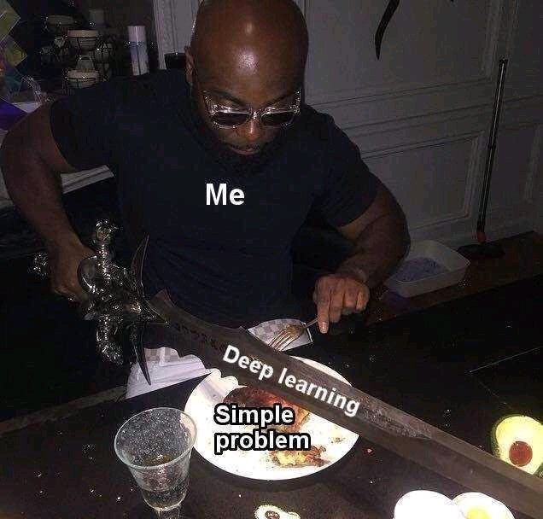

Slide 42
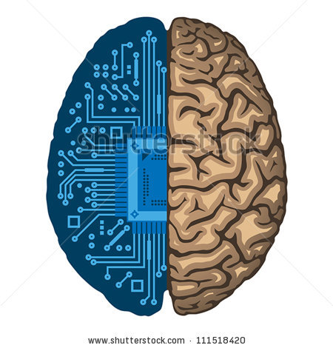
רשת נוירונים – Artificial Neural Network
מודל חישובי המאפשר לבצע הדמיה של תהליכים המתרחשים במוח
רשת המכילה בדרך כלל מספר רב של יחידות קלט ופלט המקושרות זו לזו
צורת הקישור בין היחידות מדמה את אופן חיבור הנוירונים במוח

Slide 43
רשת נוירונים – Artificial Neural Network
רשת נוירונים מורכבת מ:
הנוירון – יחידת עיבוד המידע של הרשת
מבנה – קבוצת נוירונים וקישורים בינהם (לכל קישור יש משקל)
אלגוריתם למידה – שינוי המשקולות כדי לפתור משימת למידה ע"י סט אימון

Slide 44
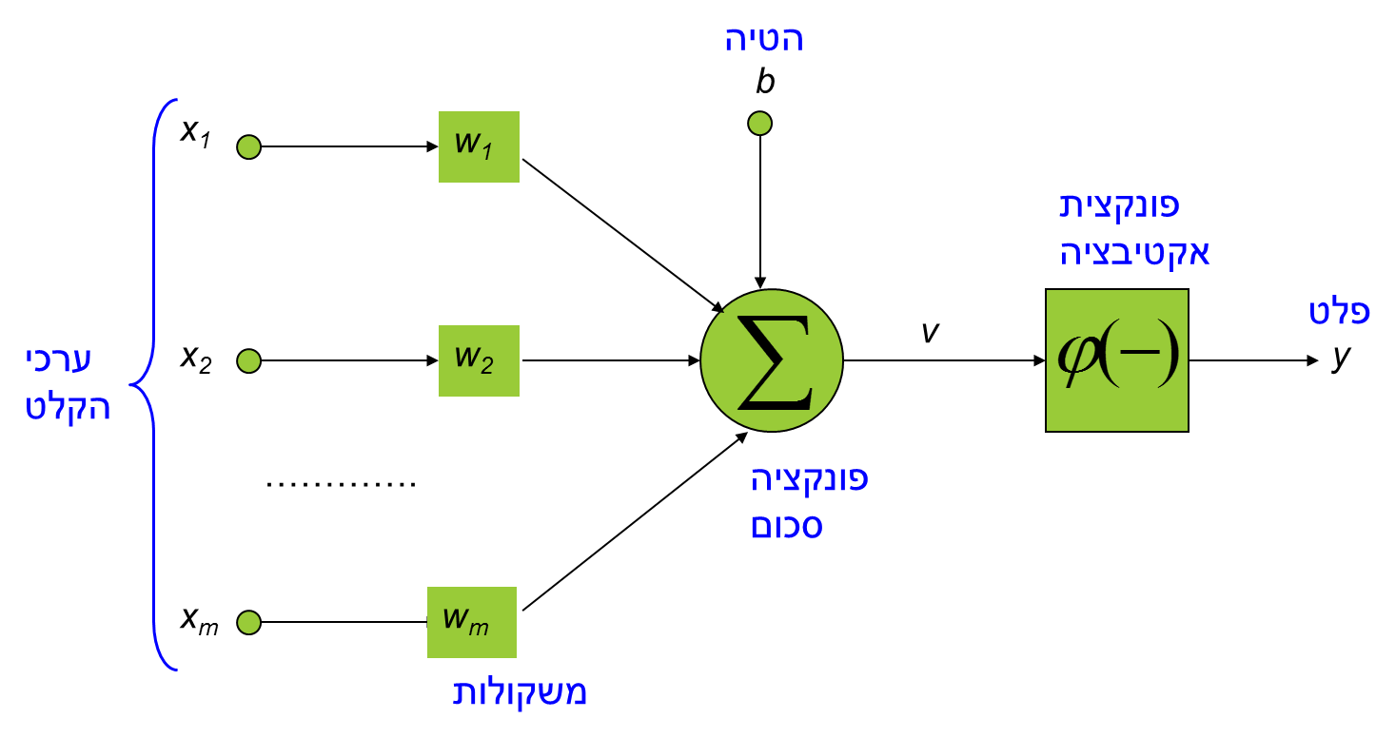
רשת נוירונים – Artificial Neural Network
הנוירון - יחידת עיבוד המידע של הרשת
משקולות: משפיעות על איכות הרשת, בדר"כ מאותחלות רנדומלית
הטיה: קלט קבוע עם משקולת מסויימת
פונקציית סכום: חישוב סכום משקל הקלט
פונקציית אקטיבציה: להגבלת גודל הטווח של הפלט

Slide 45
רשת נוירונים – Artificial Neural Network
מבנה רשת הנוירונים
קיימים 3 סוגי מבני רשתות:
single-layer feed-forward
multi-layer feed-forward
recurrent
z⁻¹
input
hidden
output
z⁻¹
z⁻¹

Slide 46
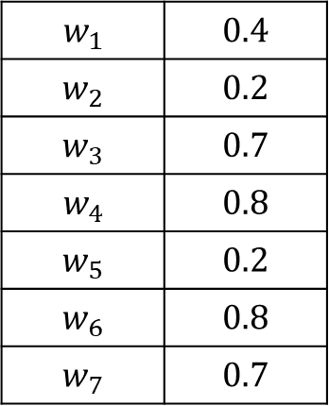
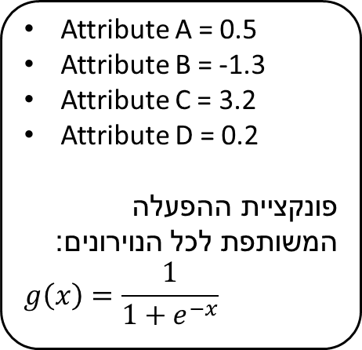
רשת נוירונים – Artificial Neural Network
נתונה רשת הנוירונים המאומנת הבאה.
כמו-כן נתונה טבלאות המשקולות הבאות.
מהו הפלט של כל נוירון בהינתן הקלט הבא?
$$w_{1}$$ | $$0.4$$
$$w_{2}$$ | $$0.2$$
$$w_{3}$$ | $$0.7$$
$$w_{4}$$ | $$0.8$$
$$w_{5}$$ | $$0.2$$
$$w_{6}$$ | $$0.8$$
$$w_{7}$$ | $$0.7$$
Attribute A = 0.5
Attribute B = -1.3
Attribute C = 3.2
Attribute D = 0.2
פונקציית ההפעלה המשותפת לכל הנוירונים:
$$g\left(x\right)=\frac{1}{1+e^{−x}}$$

Slide 47
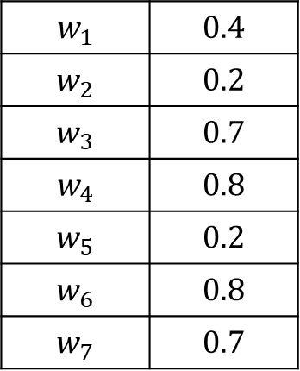
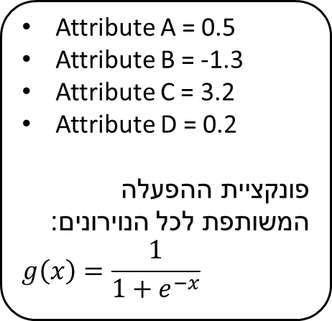
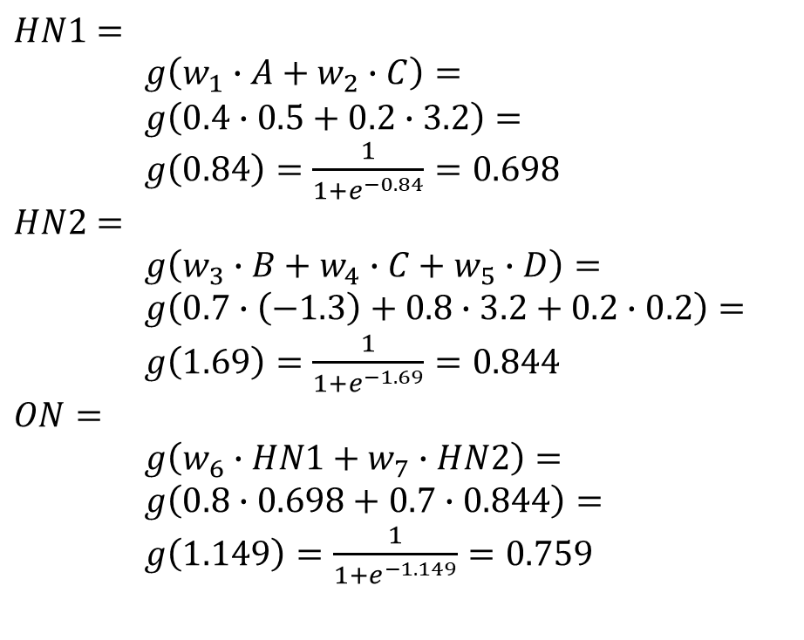
רשת נוירונים
$$w_{1}$$ | $$0.4$$
$$w_{2}$$ | $$0.2$$
$$w_{3}$$ | $$0.7$$
$$w_{4}$$ | $$0.8$$
$$w_{5}$$ | $$0.2$$
$$w_{6}$$ | $$0.8$$
$$w_{7}$$ | $$0.7$$
Attribute A = 0.5
Attribute B = -1.3
Attribute C = 3.2
Attribute D = 0.2
פונקציית ההפעלה המשותפת לכל הנוירונים:
$$g\left(x\right)=\frac{1}{1+e^{−x}}$$
$$HN1=$$
$g\left(w_{1}∙A+w_{2}∙C\right)=$
$g\left(0.4∙0.5+0.2∙3.2\right)=$
$g\left(0.84\right)=\frac{1}{1+e^{−0.84}}=0.698$
$$HN2=$$
$g\left(w_{3}∙B+w_{4}∙C+w_{5}∙D\right)=$
$g\left(0.7∙\left(−1.3\right)+0.8∙3.2+0.2∙0.2\right)=$
$g\left(1.69\right)=\frac{1}{1+e^{−1.69}}=0.844$ $$ON=$$
$g\left(w_{6}∙HN1+w_{7}∙HN2\right)=$
$g\left(0.8∙0.698+0.7∙0.844\right)=$
$g\left(1.149\right)=\frac{1}{1+e^{−1.149}}=0.759$

Slide 48

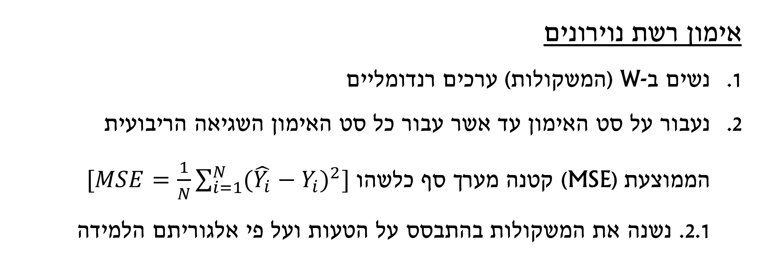
רשת נוירונים – Artificial Neural Network
אימון רשת נוירונים
נשים ב-W (המשקולות) ערכים רנדומליים
נעבור על סט האימון עד אשר עבור כל סט האימון השגיאה הריבועית הממוצעת (MSE) קטנה מערך סף כלשהו $[MSE=\frac{1}{N}\sum_{i=1}^{N}{{(\hat{Y_{i}}−Y_{i})}^{2}}]$
2.1. נשנה את המשקולות בהתבסס על הטעות ועל פי אלגוריתם הלמידה

Slide 49
אימון Perceptron

Slide 50
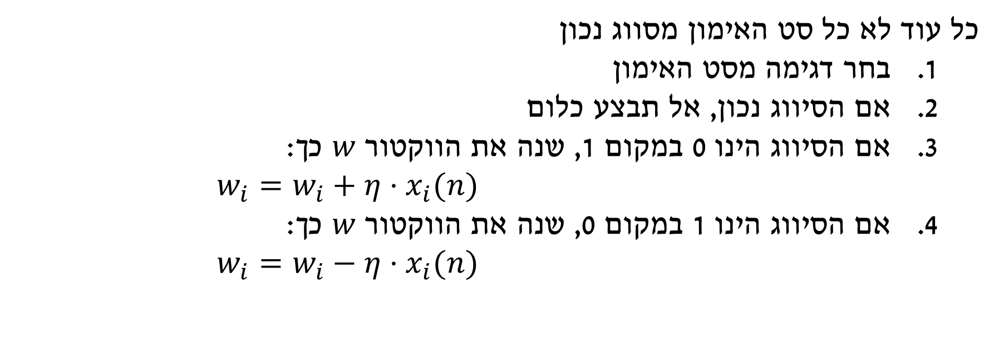
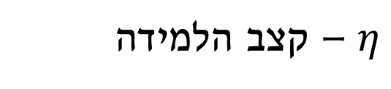

אימון Perceptron
$$d\left(n\right)=\left\{\begin{aligned}0 ,x\left(n\right)∈set A \\ 1 ,x\left(n\right)∈set B\end{aligned}\right.$$
פלט רצוי
כל עוד לא כל סט האימון מסווג נכון
בחר דגימה מסט האימון
אם הסיווג נכון, אל תבצע כלום
אם הסיווג הינו 0 במקום 1, שנה את הווקטור $w$ כך: $w_{i}=w_{i}+η⋅x_{i}(n)$
אם הסיווג הינו 1 במקום 0, שנה את הווקטור $w$ כך: $w_{i}=w_{i}−η⋅x_{i}(n)$
$η$ – קצב הלמידה

Slide 51







רשת נוירונים – Artificial Neural Network
לקוח מועדף | הכנסה חודשית (אש"ח) | גיל
לא | 9 | 39
כן | 16 | 40
כן | 8 | 18
כן | 12.2 | 24
לא | 5 | 29
נתונות התצפיות הבאות לגבי לקוחות מועדפים בבנק ע"פ 2 התכונות שבטבלה (גיל, הכנסה חודשית)
מעוניינים לחזות מי יהיה לקוח מועדף לפי גילו והכנסתו
עליכם לאמן את רשת הנוירונים כך שתהיה קונסיסטנטית עם התצפיות
$$b$$
גיל
$$w_{1}$$
$$N$$
$1$ – כן
$0$ – לא
$$w_{2}$$
הכנסה
$$g_{i}(a_{i})=\left\{\begin{aligned}1 , a_{i}≥1 \\ 0 , else\end{aligned}\right\}$$
$$η=0.05$$

Slide 52




רשת נוירונים – Artificial Neural Network
לקוח מועדף | הכנסה חודשית (אש"ח) | גיל
לא | 9 | 39
כן | 16 | 40
כן | 8 | 18
כן | 12.2 | 24
לא | 5 | 29
$N=g\left({w_{0}+w}_{1}∙AGE+w_{2}∙INCOME\right)$=
= $g(1+1$ $∙39+1∙9)$=
= $g\left(49\right)=1$
$w_{0}=w_{0}−0.05$ $=0.95$
$$w_{1}=w_{1}−0.05 ∙39=−0.95$$
$$w_{2}=w_{2}−0.05 ∙9=0.55$$
$$w_{0}=1$$
$$w_{1}=1 \\ w_{2}=1$$
$$w_{0}$$
גיל
$$w_{1}$$
$$N$$
$1$ – כן
$0$ – לא
$$w_{2}$$
הכנסה
$$g_{i}(a_{i})=\left\{\begin{aligned}1 , a_{i}≥1 \\ 0 , else\end{aligned}\right\}$$
$$η=0.05$$

Slide 53


רשת נוירונים – Artificial Neural Network
לקוח מועדף | הכנסה חודשית (אש"ח) | גיל
לא | 9 | 39
כן | 16 | 40
כן | 8 | 18
כן | 12.2 | 24
לא | 5 | 29
$N=g\left({w_{0}+w}_{1}∙AGE+w_{2}∙INCOME\right)$=
= $g(0.95−0.95$ $∙40+0.55∙16)$=
= $g\left(−28.25\right)=0$
$w_{0}=w_{0}+0.05$ $=1$
$$w_{1}=w_{1}+0.05 ∙40=1.05$$
$$w_{2}=w_{2}+0.05 ∙16=1.35$$
$$w_{0}=0.95$$
$$w_{1}=−0.95 \\ w_{2}=0.55$$
$$w_{0}$$
גיל
$$w_{1}$$
$$N$$
$1$ – כן
$0$ – לא
$$w_{2}$$
הכנסה
$$g_{i}(a_{i})=\left\{\begin{aligned}1 , a_{i}≥1 \\ 0 , else\end{aligned}\right\}$$
$$η=0.05$$

Slide 54


רשת נוירונים – Artificial Neural Network
לקוח מועדף | הכנסה חודשית (אש"ח) | גיל
לא | 9 | 39
כן | 16 | 40
כן | 8 | 18
כן | 12.2 | 24
לא | 5 | 29
$N=g\left({w_{0}+w}_{1}∙AGE+w_{2}∙INCOME\right)$=
= $g(1+1.05$ $∙18+1.35∙8)$=
= $g\left(30.7\right)=1$
$$w_{0}=1$$
$$w_{1}=1.05 \\ w_{2}=1.35$$
$$w_{0}$$
גיל
$$w_{1}$$
$$N$$
$1$ – כן
$0$ – לא
$$w_{2}$$
הכנסה
$$g_{i}(a_{i})=\left\{\begin{aligned}1 , a_{i}≥1 \\ 0 , else\end{aligned}\right\}$$
$$η=0.05$$

Slide 55

רשת נוירונים – Artificial Neural Network
לקוח מועדף | הכנסה חודשית (אש"ח) | גיל
לא | 9 | 39
כן | 16 | 40
כן | 8 | 18
כן | 12.2 | 24
לא | 5 | 29
$N=g\left({w_{0}+w}_{1}∙AGE+w_{2}∙INCOME\right)$=
= $g(1+1.05$ $∙24+1.35∙12.2)$=
= $g\left(42.67\right)=1$
$$w_{0}=1$$
$$w_{1}=1.05 \\ w_{2}=1.35$$
$$w_{0}$$
גיל
$$w_{1}$$
$$N$$
$1$ – כן
$0$ – לא
$$w_{2}$$
הכנסה
$$g_{i}(a_{i})=\left\{\begin{aligned}1 , a_{i}≥1 \\ 0 , else\end{aligned}\right\}$$
$$η=0.05$$

Slide 56

רשת נוירונים – Artificial Neural Network
לקוח מועדף | הכנסה חודשית (אש"ח) | גיל
לא | 9 | 39
כן | 16 | 40
כן | 8 | 18
כן | 12.2 | 24
לא | 5 | 29
$N=g\left({w_{0}+w}_{1}∙AGE+w_{2}∙INCOME\right)$=
= $g(1+1.05$ $∙29+1.35∙5)$=
= $g\left(38.2\right)=1$
$w_{0}=w_{0}−0.05$ $=0.95$
$$w_{1}=w_{1}−0.05 ∙29=−0.4$$
$$w_{2}=w_{2}−0.05 ∙5=1.1$$
$$w_{0}=1$$
$$w_{1}=1.05 \\ w_{2}=1.35$$
$$w_{0}$$
גיל
$$w_{1}$$
$$N$$
$1$ – כן
$0$ – לא
$$w_{2}$$
הכנסה
$$g_{i}(a_{i})=\left\{\begin{aligned}1 , a_{i}≥1 \\ 0 , else\end{aligned}\right\}$$
$$η=0.05$$

Slide 57


רשת נוירונים – Artificial Neural Network
לקוח מועדף | הכנסה חודשית (אש"ח) | גיל
לא | 9 | 39
כן | 16 | 40
כן | 8 | 18
כן | 12.2 | 24
לא | 5 | 29
$$N=0$$
$$N=1$$
$$N=1$$
$$N=1$$
$$N=0$$
$$w_{0}=0.95$$
$$w_{1}=−0.4 \\ w_{2}=1.1$$
$$w_{0}$$
גיל
$$w_{1}$$
$$N$$
$1$ – כן
$0$ – לא
$$w_{2}$$
הכנסה
$$g_{i}(a_{i})=\left\{\begin{aligned}1 , a_{i}≥1 \\ 0 , else\end{aligned}\right\}$$
$$η=0.05$$

Slide 58
Artificial Neural network

Slide 59


Classification by Backpropagation
A neural network: A set of connected input/output units (neurons) where each connection has a weight associated with it
During the learning phase, the network learns by adjusting the weights

Slide 60
Node Biases
A node’s output is a weighted function of its inputs and a ‘bias’ term
Output
1
Input
bias
These biases also need to be learned!

Slide 61
Training Biases ( Θ’s )
A node’s output
1 if W₁ X₁ + W₂ X₂ +…+ W_{n} X_{n} ≥ Θ
0 otherwise
Rewriting
W₁ X₁ + W₂ X₂ + … + W_{n} X_{n} – Θ ≥ 0
W₁ X₁ + W₂ X₂ + … + W_{n} X_{n} + Θ × (-1) ≥ 0
weight
activation

Slide 62
Training Biases (cont.)
Hence, add another unit whose activation is always -1
So the bias is just another weight!
E.g.
Θ
-1
Θ

Slide 63
Neural Network as a Classifier
Weakness
Strengths

Slide 64
Neural Network as a Classifier
Weakness
Long training time
Best parameter settings typically determined empirically
Poor interpretability
Strengths
High tolerance to noisy data
Ability to classify untrained patterns
Well-suited for continuous-valued inputs and outputs
Successful on an array of real-world data, e.g., hand-written letters
Algorithms are inherently parallel
Techniques have recently been developed for the extraction of rules from trained neural networks (still an active research area)

Slide 65
Backpropagation
Iteratively process a set of training tuples & compare the network's prediction with the actual known target value
For each training tuple, the weights are modified to minimize a loss function (e.g., the mean squared error) between the network's prediction and the actual target value
Modifications are made in the “backwards” direction: from the output layer, through each hidden layer down to the first hidden layer, hence “backpropagation”
Steps
Initialize weights to small random numbers, associated with biases
Propagate the inputs forward (by applying activation function)
Backpropagate the error (by updating weights and biases)
Terminating condition (when error is very small, etc.)

Slide 66
Weight Space
Given a neural-network layout, the weights and biases are free parameters that define a space
Each point in this Weight Space specifies a network
weight space is a continuous space we search
Associated with each point is an error rate, E, over the training data
Backprop performs gradient descent in weight space

Slide 67


Slide 68

The Gradient-Descent Rule

Slide 69
‘On Line’ vs. ‘Batch’ Backprop
Technically, we should look at the error gradient for the entire training set, before taking a step in weight space (‘batch’ backprop)
However, in practice we take a step after each example (‘on-line’ backprop)
Much faster convergence (learn after each example)
Called ‘stochastic’ gradient descent
Stochastic gradient descent quite popular at Google, Facebook, Microsoft, etc. due to easy parallelism

Slide 70

Gradient Descent for the Perceptron

Slide 71

Perceptron Example: Autonomous Vehicle

Slide 72

Perceptron Example: Autonomous Vehicle

Slide 73

Perceptron Example: Autonomous Vehicle

Slide 74

Backpropagation Algorithm
Calculate error
error≤error_{min}

Slide 75
Backpropagation Algorithm
The error of unit j in the output layer:
Calculate error
The error of unit j in the hidden layer:
O_{j} – actual output
T_{j} – known target value of the given training tuple
w_{jk} - the weight of the connection from unit j to a unit k in the next layer
Err_{k} - the error of unit k

Slide 76

Backpropagation Algorithm
Calculate error
Update the weights and the biases:
$l$ – the learning rate, a constant typically having a value between 0.0 and 1.0.

Slide 77
Backpropagation Algorithm

Slide 78
Example - Multilayer Feed-Forward NN
X₁
1
w₁₄
w₁₅
4
w₄₆
Learning rate = 0.9
w₂₄
2
6
X₂
w₂₅
X=(1,0,1)
Class label = 1
5
w₅₆
w₃₄
X₃
3
w₃₅

Slide 79
Example - Multilayer Feed-Forward NN
X=(1,0,1)
Class label = 1
Learning rate = 0.9
Initial input, Weight, and Bias values
1
1
0.2
-0.3
-0.4
-0.3
For a unit j in the output layer:
0.4
2
0.1
0
0.1
For the error of a hidden layer unit j:
0.2
-0.2
-0.5
1
3
0.2
Calculating the updated weights and biases:

Slide 80

1
1
0.2
-0.3
-0.4
-0.3
0.4
2
0.1
0
0.1
0.2
-0.2
Calculating the output of the network for the first tuple
-0.5
Unit, j | Net input, I_{j} | Output O_{j}
4 | 0.2+0-0.5-0.4 = -0.7 | $$\frac{1}{1+e^{−(−0.7)}}=0.332$$
5 | -0.3+0+0.2+0.2 = 0.1 | $$\frac{1}{1+e^{−(0.1)}}=0.525$$
6 | (-0.3)(0.332)-(0.2)(0.525)+0.1 = -0.105 | $$\frac{1}{1+e^{−(−0.105)}}=0.474$$
1
3
0.2

Slide 81
Multilayer feed-forward NN – Ex.
lr
Calculating the updated weights and biases:
Backpropagate the error:
For a unit j in the output layer:
U6
New value | Weight or bias
-0.3+(0.9)(0.1311)(0.332)=-0.261 | W₄₆
-0.2+(0.9)(0.1311)(0.525)=-0.138 | W₅₆
0.2+(0.9)(-0.0087)(1)=0.192 | w₁₄
-0.3+(0.9)(-0.0065)(1)=-0.306 | w₁₅
0.4+(0.9)(-0.0087)(0)=0.4 | W₂₄
0.1+(0.9)(-0.0065)(0)=0.1 | W₂₅
0.5+(0.9)(-0.0087)(1)=-0.508 | w₃₄
0.2+(0.9)(-0.0065)(1)=0.194 | W₃₅
0.1+(0.9)(0.1131)=0.218 | ϴ₆
0.2+(0.9)(-0.0065)=0.194 | ϴ₅
-0.4+(0.9)(-0.0087)=-0.408 | ϴ₄
U4
For the error of a hidden layer unit j:
Unit, j | Err_{j}
6 | (0.474)(1-0.474)(1-0.474) = 0.1311
5 | (0.525)(1-0.525)(0.1311)(-0.2) = -0.0065
4 | (0.332)(1-0.332)(0.1311)(-0.3) = -0.0087

Slide 82
1
0.2
-0.3
-0.4
-0.3
0.4
2
0.1
0.1
0.2
-0.2
1
-0.5
0.192
3
0.2
-0.306
-0.408
-0.261
0.4
2
0.218
0.1
0.194
-0.138
-0.598
3
0.194

Slide 83

The learning process

